Slide 1

Inmate Insider: Revolutionizing Prison Management
Coral S. Schmidt Montilla #148830
Gabriel o. Gonzales Rios #141406
Kevin G. Quintero Ramirez #133009

Slide 2

Problem Statement
Challenges in Data Management
The lack of a centralized database system and the reliance on manual methods hinder efficiency and security in prison data management.
Negative Consequences
The difficulty in adding, modifying, and searching inmate data leads to the risk of errors, inconsistencies, and security breaches.
Addressing the Issue
Inmate Insider aims to address these challenges by promising efficiency, security, and rehabilitation in prison management.
Photos provided by Pexels

Slide 3
Objectives
Security and Privacy
User-Friendly UI
Efficiency and Accuracy
Ensuring the security and privacy of inmate information with a centralized database management system.
Developing a user-friendly interface for managing prisoner data, with emphasis on easy addition, modification, and search functionalities for prisoner records.
Enhancing efficiency and accuracy in prison management processes through Inmate Insider's features.

Slide 4
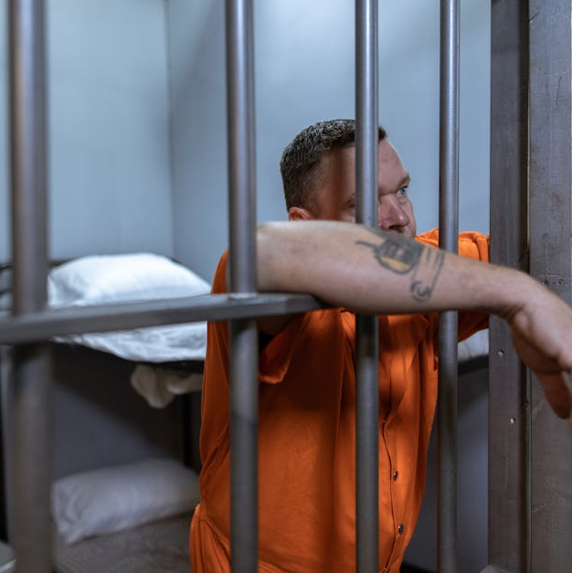
Features of Inmate Insider
Addition of Prisoners
User-friendly interface for quickly adding new prisoners to the database and capturing essential details, thus streamlining the process.
Modification of Prisoners
User-oriented editing tools for easy updating of prisoner records and a streamlined process for modifying inmate information.
Search Functionality and Database Visualization
Easy search capabilities requiring only the prisoner's ID and visual representation of prisoner data for easy interpretation and analysis.
Photos provided by Pexels

Slide 5

Benefits
Improved Efficiency
Enhanced Security
Inmate Insider improves efficiency in managing prisoner data, reducing errors and inconsistencies in inmate records.
Centralized database management leads to enhanced security and privacy, ensuring accurate and reliable inmate information.
Transformative Impact
Inmate Insider redefines prison management, leading to a transformative journey towards accountability and rehabilitation.

Slide 6

Implementation Plan
System Integration and Testing
Collaboration with prison authorities for the integration and testing of the Inmate Insider system within prison facilities.
Training Sessions
Conducting training sessions for prison staff on using the Inmate Insider UI effectively to ensure effective adoption of the system.
Feedback Collection
Continuous monitoring and feedback collection from prison staff for further improvements and optimization of the system.
Photos provided by Pexels

Slide 7
Live showing of product

Slide 8
Conclusion
Impact on Staff and Inmates
Streamlined Processes
Enhanced Security and Rehabilitation
Inmate Insider's impact is not only felt by staff but also enhances the overall rehabilitation and accountability for inmates.
Inmate Insider streamlines prison management processes, equipping staff with intuitive tools for informed decision-making.
The system enhances security and embarks on a transformative journey towards accountability and rehabilitation in prison management.

